Slide 1


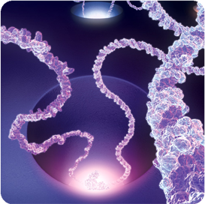
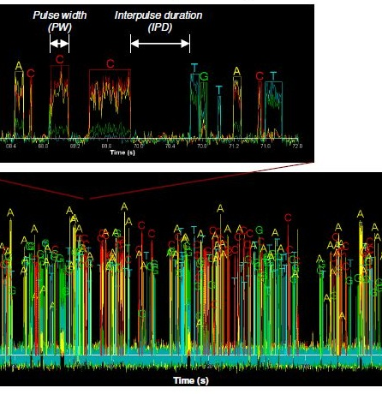


Real time single molecule sequencing
For Virus-Induced Gene Silencing( VIGS) promotor region identification in Erycina pusilla
Elio Schijlen, 27 February 2014

Slide 2
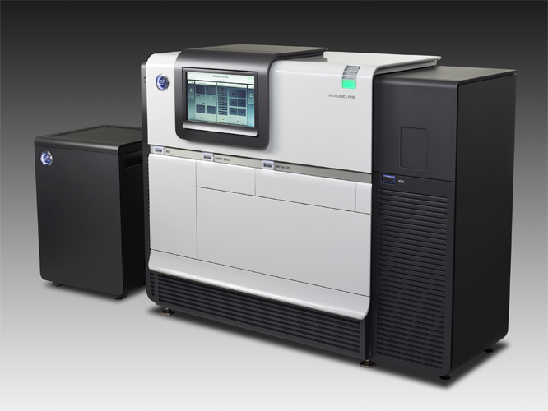

3^{d} Gen Sequencing: PacBio
SMRT sequencing
Kb read length
<50,000 reads
1-5 Gb/run

Slide 3
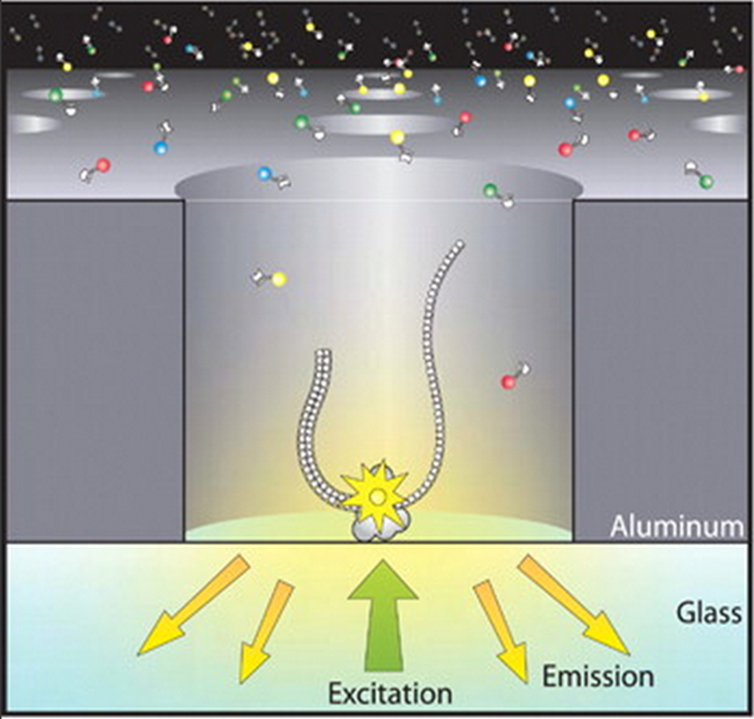
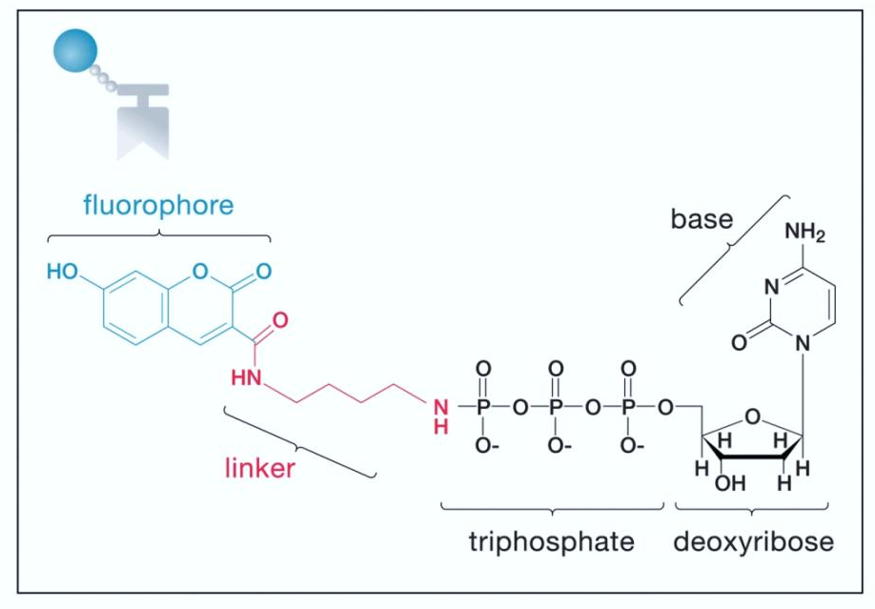
Pacbio sequencing
Phospholinked
Cleavage by
DNA polymerase
Fluorophore clipped off by polymerase
DNA synthesized is natural
No steric hindrance or accumulation of background signal
ZMW Zero Mode Waveguide
Notes:
In contrast to using base-linked nucleotides, our SMRT Sequencing uses nucleotides which have the fluorescent dye attached to the other end of the molecule – the poly-phosphate chain. Through such attachment, incorporation of a phospholinked nucleotide by the DNA polymerase results in separation of the dye molecule from the nucleotide when the enzyme cleaves the phosphate chain. The phosphate chain-dye complex floats away by diffusion, leaving behind a natural, unmodified strand of DNA, thus eliminating the problems of steric hinderance and accumulation of background signal.

Slide 4
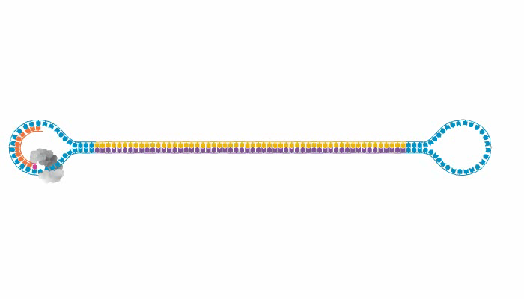
SMRT bell template sequencing
Notes:
Pacific Biosciences has developed Single Molecule Real Time (SMRT™) DNA sequencing technology. This technology enables, for the first time, direct observation of natural DNA synthesis by a DNA polymerase as it occurs in real time. One of the unique features of this technology is that it allows for sequencing read lengths longer than any existing technology. Two uses for long read length immediately come to mind. The first is to use that read length to repeatedly sequence a short template and thereby generate a consensus based upon a single template molecule. The second is to use the long read length to sequence a correspondingly long template. The challenge was how to efficiently produce templates that cover the range of sizes that was required. The SMRTbell™ preparation method was developed to address this challenge by creating a circularized template that can be used with multiple sequencing protocols. A single streamlined protocol is used to create templates of varying insert lengths, ranging from 200 bp to 10,000 bp depending on the needs of the application. This protocol is adaptable to any of several standard fragmentation methods, or no fragmentation when starting with PCR products. Amplification is not a required component of library preparation. However, in situations where limited DNA is available or for targeted sequencing applications, the protocol can be used with standard amplification products. The remaining sections of this presentation will provide a quick overview of each of the steps in the SMRTbell library preparation process.

Slide 5
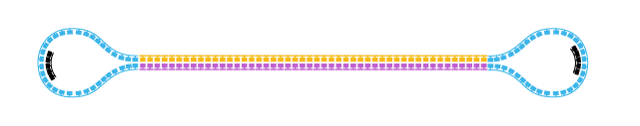
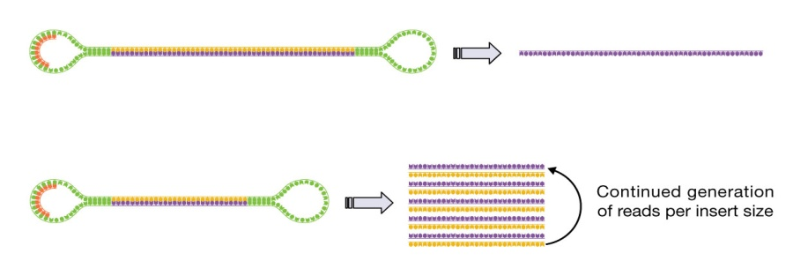
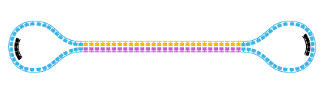
Universal SMRTbell Template
Standard Sequencing
Large Insert Sizes
Generates one pass on each molecule sequenced
Single pass accuracy 85%
Circular Consensus Sequencing
Small Insert Sizes
Generates multiple passes on each molecule sequenced
3 passes : consensus accuracy >95%
5 passes : consensus accuracy >99%
Notes:
The SMRTbell template format can be used for standard, and circular consensus sequencing. For standard sequencing, each SMRTbell template generates one pass on each molecule sequenced. For smaller insert sizes the SMRTbell template allows multiple reads to be generated on each molecule. These can be combined together to generate a consensus read for each template.

Slide 6
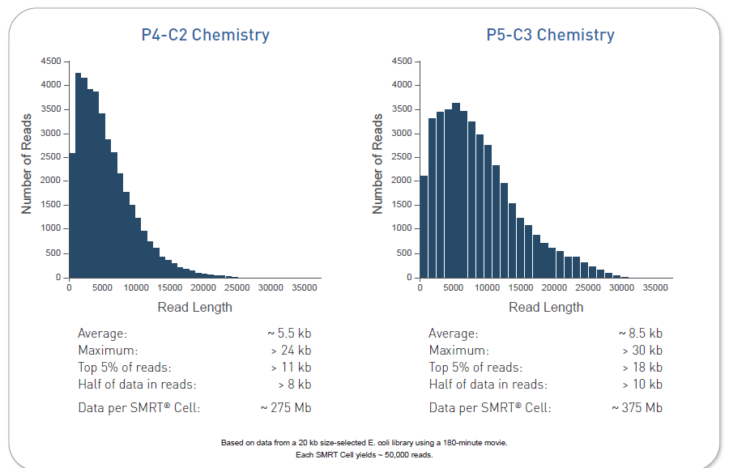
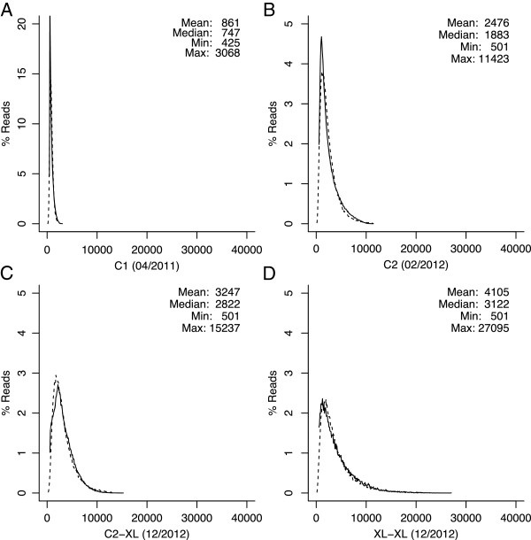

Slide 7
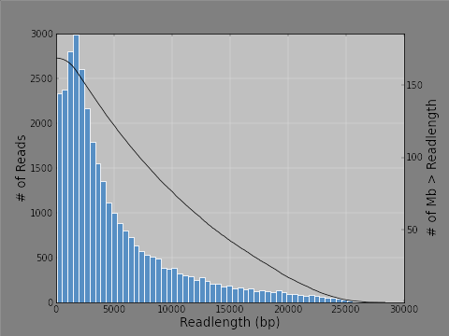
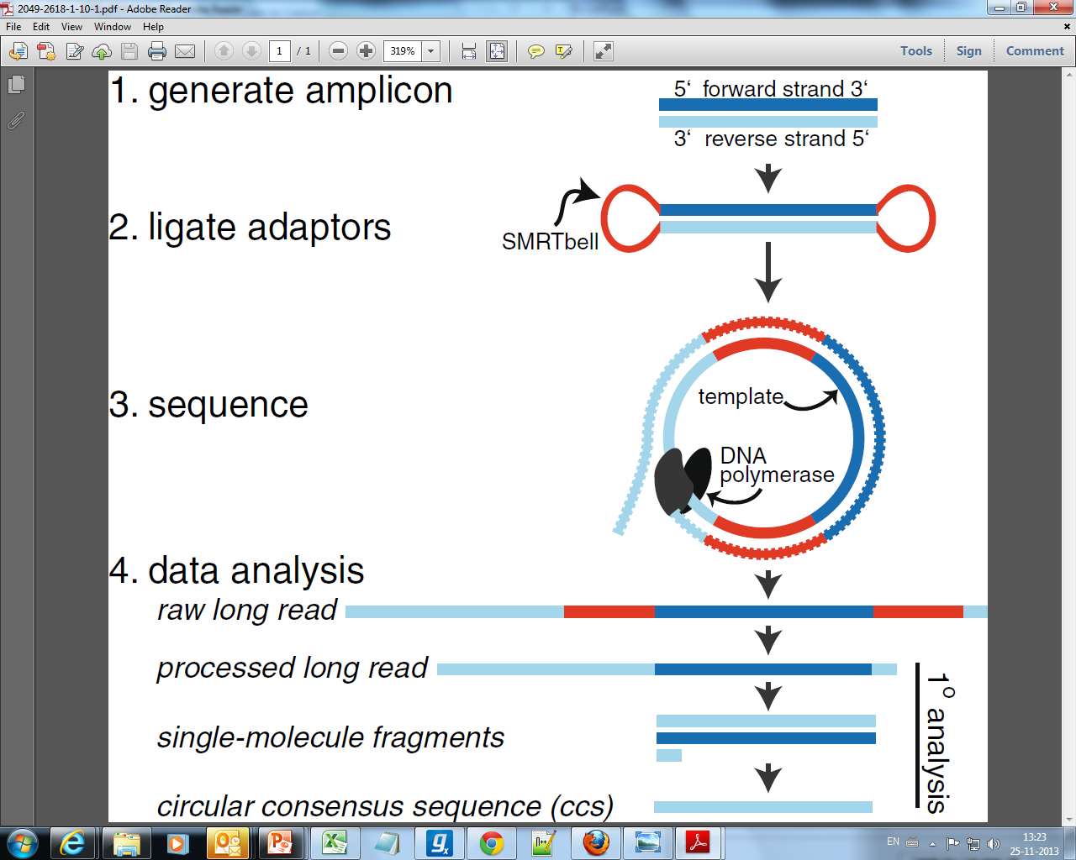
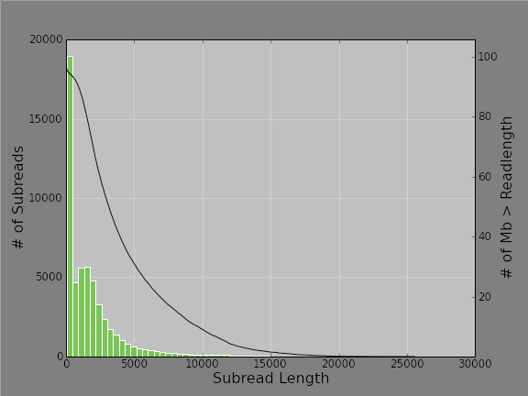
1. DNA fragmentation

Slide 8
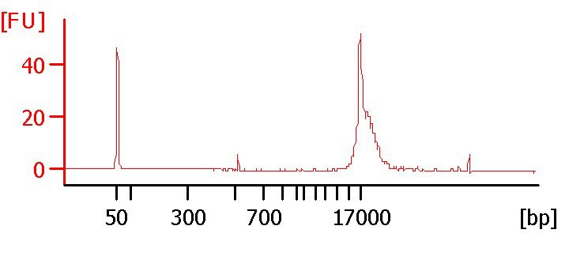
Blue pippin isolated SMRT bells

Slide 9
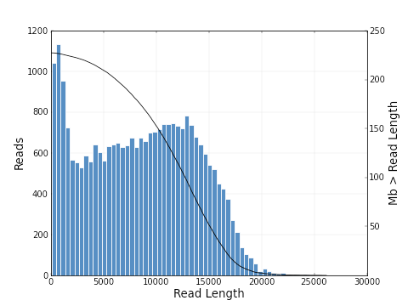
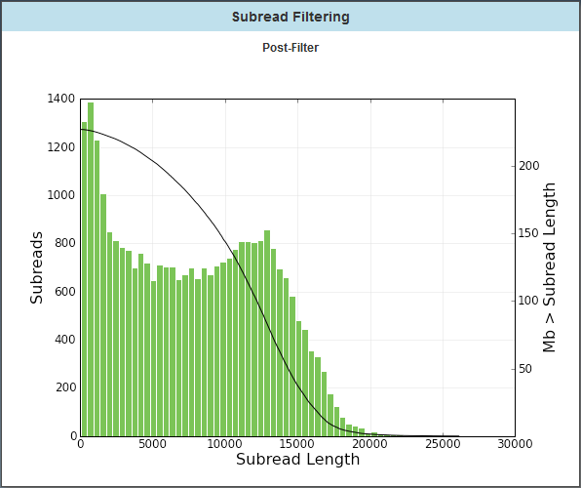
Improved polymerase, and chemistry > longer raw read length Improved library prep protocols for 20 Kb inserts Improved SMRT bell isolation (blue pippin) > long subreads !!

Slide 10
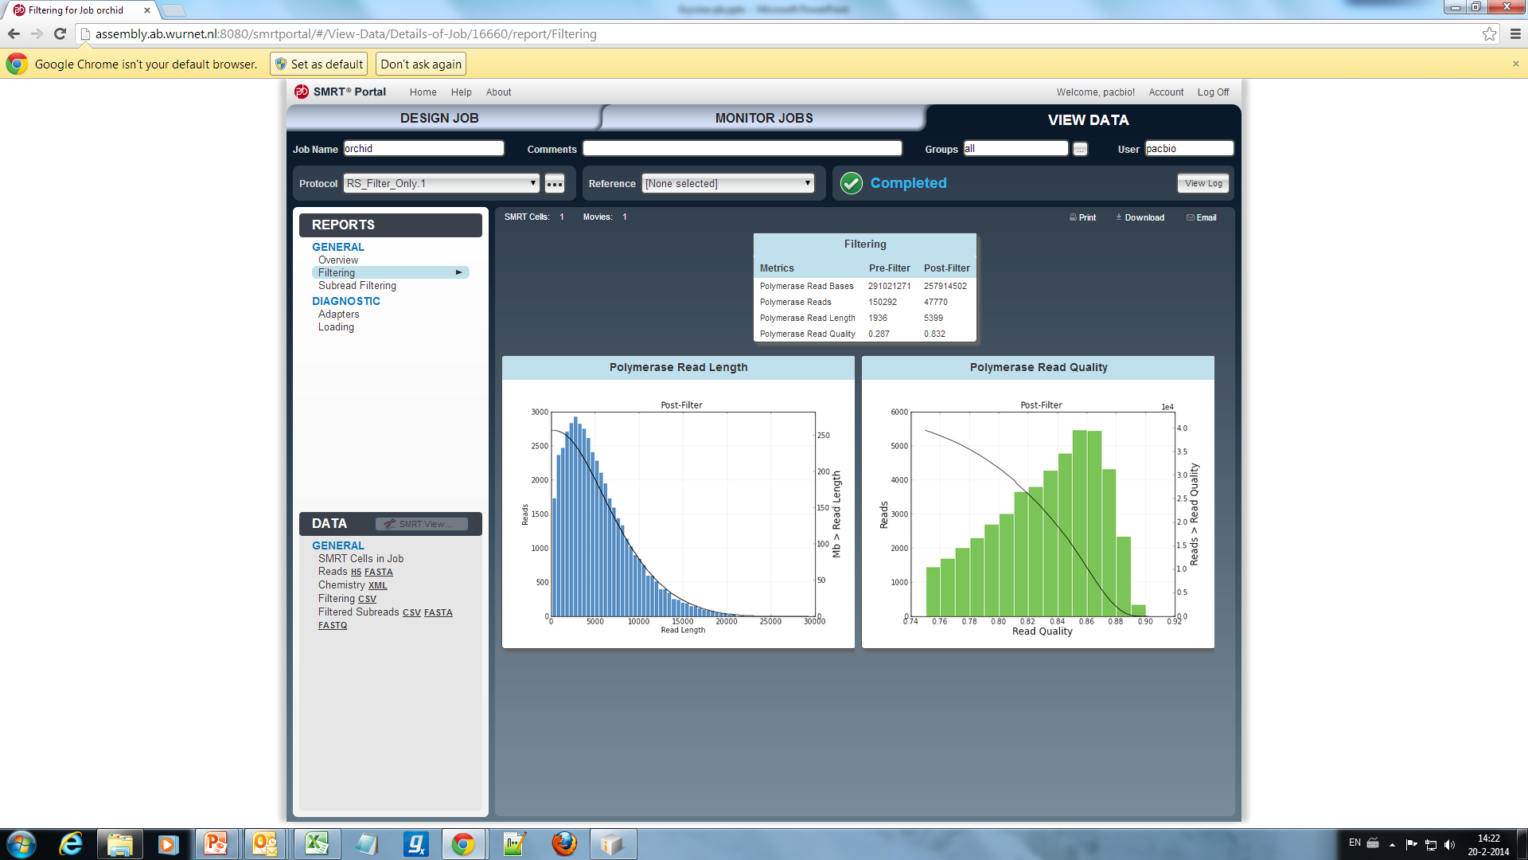
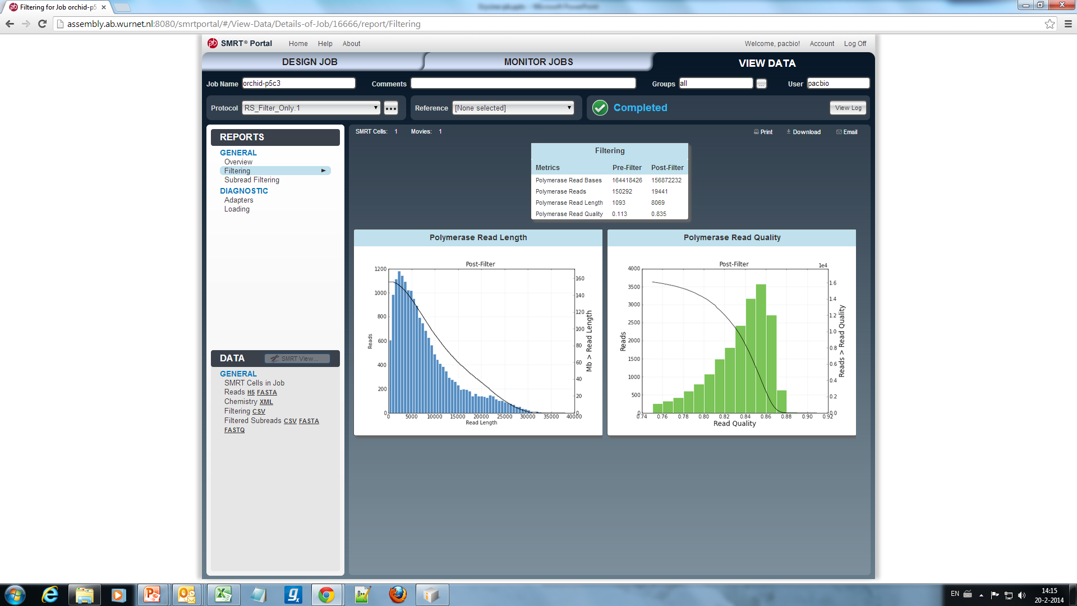
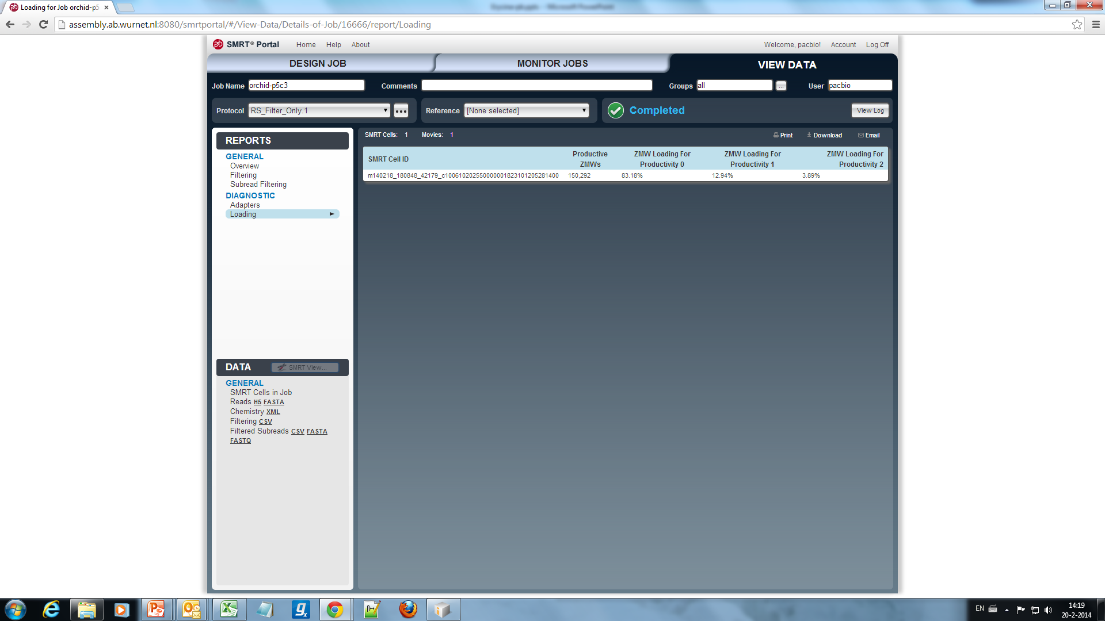
PacBio sequencing Erycina pusilla
P4/C2
P5/C3

Slide 11
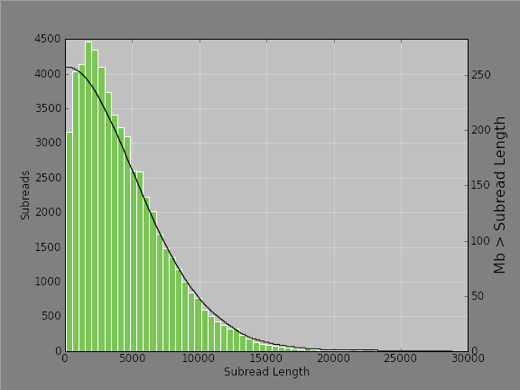
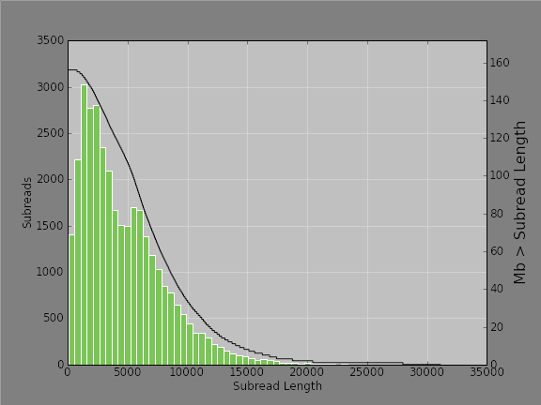
P4/C2
P5/C3
Mean Subread length | 4,351 | N50 | 6,217
Total Number of Bases | 257,263,584 | Number of Reads | 59,123
Mean Subread length | 4,613 | N50 | 6,587
Total Number of Bases | 156,105,916 | Number of Reads | 33,838
Subreads/polymerase reads
59123/47770 = 1.24
Subreads/polymerase reads
33838/19441 = 1.74
Calculated total bases if equally loaded:
383 Mb

Slide 12
Conclusion/discussion
Pacbio sequencing succesful
Large insert library prep
Large readlength
For optimal sequencing
multiple SMRT cells
Titration for loading
HMW DNA critical
Promissing technology for different applications
genome, amplicon, transcriptome, hybrid sequencing

Slide 13
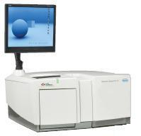
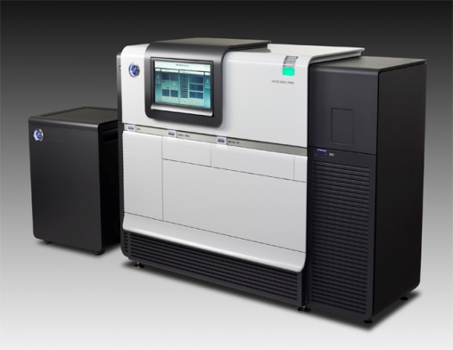
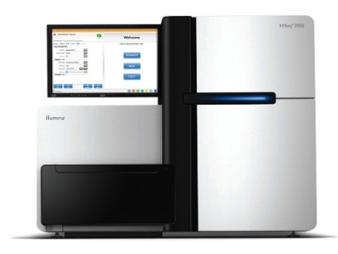
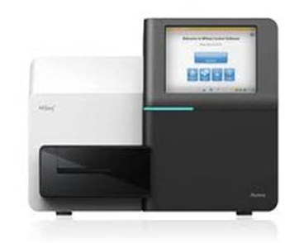
454 FLX+
RL median 900 bp
~1E06 reads
<1 Gbases
Pacbio RS-II
RL median >6000 bp
~250E+03 reads
1-5 Gbases
RL 2*100 bp
1E+09 reads
~250 Gbases
RL 2*300bp
20-25 M reads
~15 Gbases
Illumina HiSeq2000
Illumina MiSeq

Slide 14
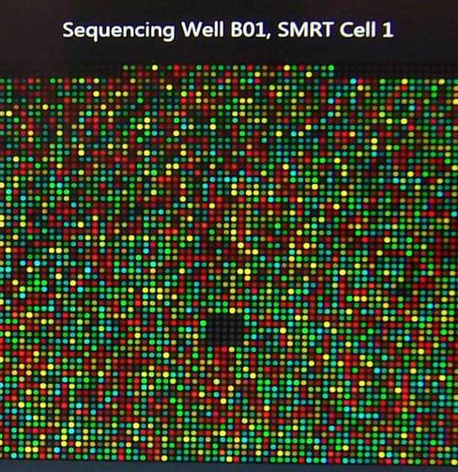
Gabino Sanchez Perez
Henri van de Geest
Thamara Hesselink
Elio Schijlen
Naturalis Biodiversity Center
Hogeschool Leiden
Barbara Gravendeel
Anita Dirks

